Slide 1
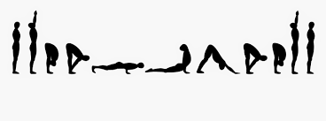
Classic Sun Salutation

Slide 2
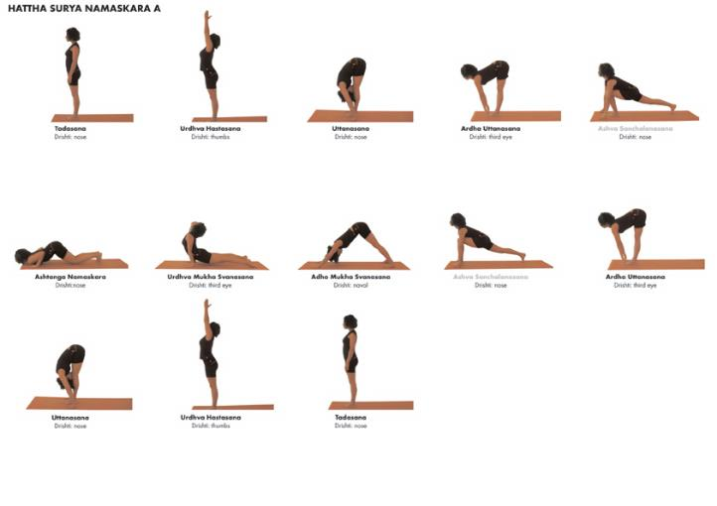
Sun salutation A

Slide 3
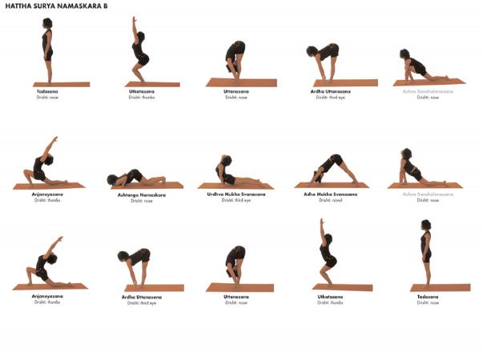
Sun salutation B

Slide 4
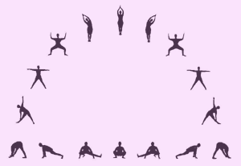
Moon Salutation

Slide 5
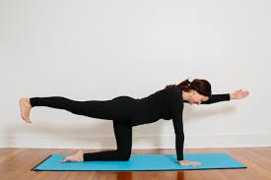
birdog

Slide 6
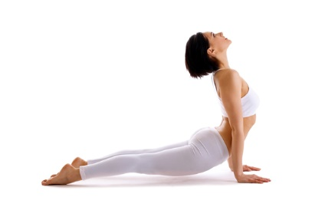
Upward facing dog

Slide 7
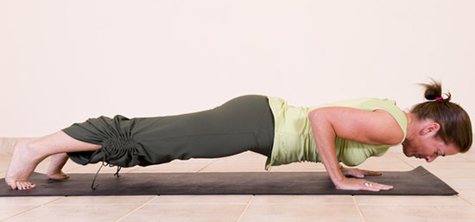
Chaturanga or low plank

Slide 8
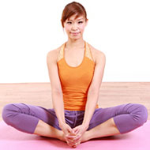
Bound angle

Slide 9
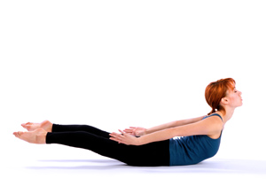
Locust

Slide 10
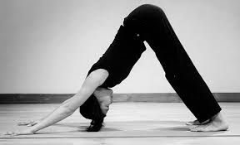
Downward Facing Dog

Slide 11
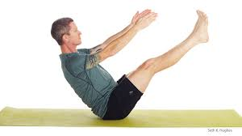
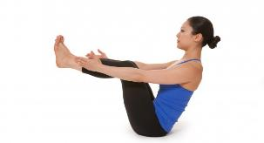
Boat

Slide 12
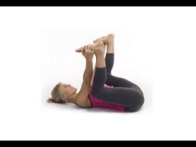
Happy Baby

Slide 13
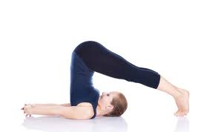
plow

Slide 14
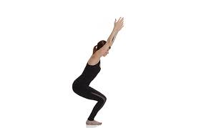
Chair Pose

Slide 15
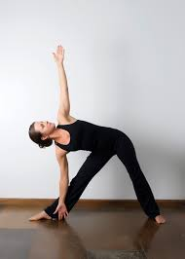
Triangle

Slide 16
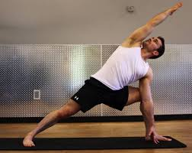
Extended Side Angle

Slide 17
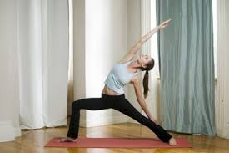
Reverse Warrior

Slide 18
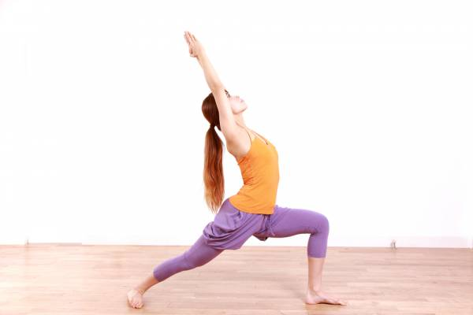
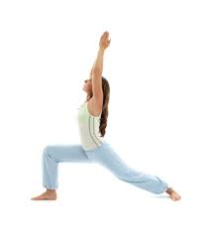
Warrior One

Slide 19
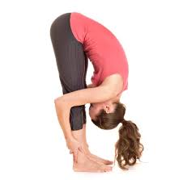
Standing Forward Fold

Slide 20
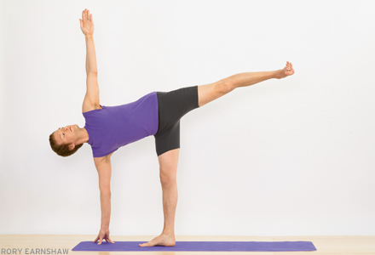
Half Moon Balance

Slide 21
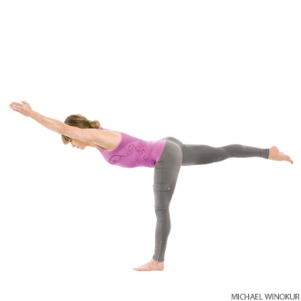
Warrior Three

Slide 22
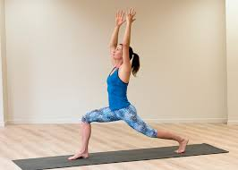
Crescent Pose

Slide 23
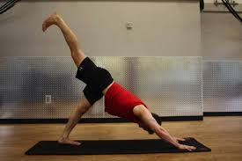
Extended leg downward dog

Slide 24
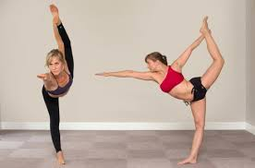
Dancer

Slide 25
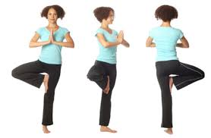
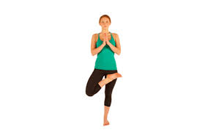
Oak

Slide 26
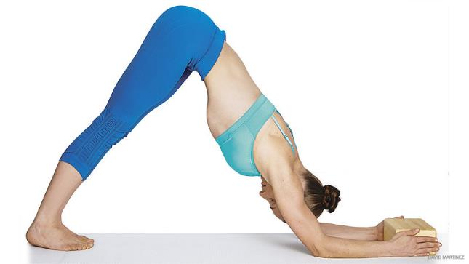
Dolphin

Slide 27
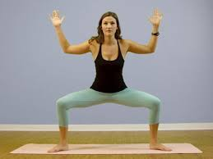
Goddess

Slide 28
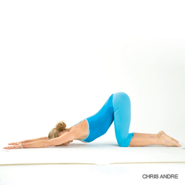
Puppy dog

Slide 29
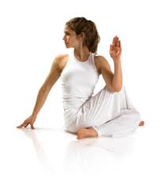
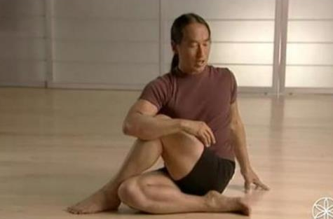
Seated half-fish or lord of the fishes

Slide 30
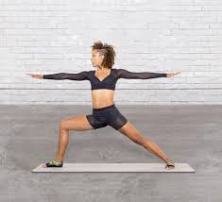
Warrior Two

Slide 31
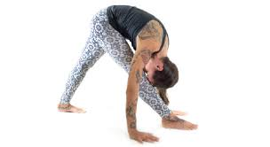
Pyramid

Slide 32
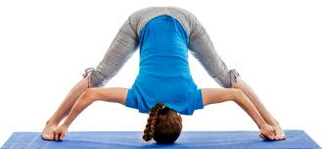
Wide-legged forward fold

Slide 33
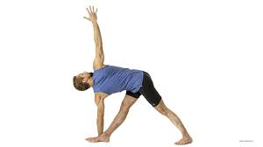
Revolved Triangle

Slide 34
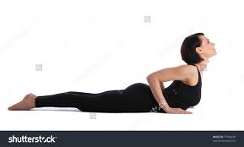
cobra

Slide 35
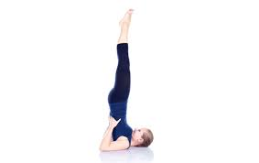
Candlestick

Slide 36
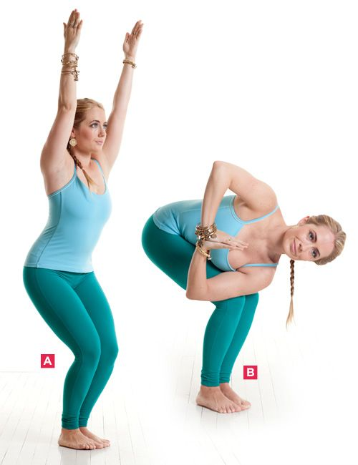
Revolved chair

Slide 37
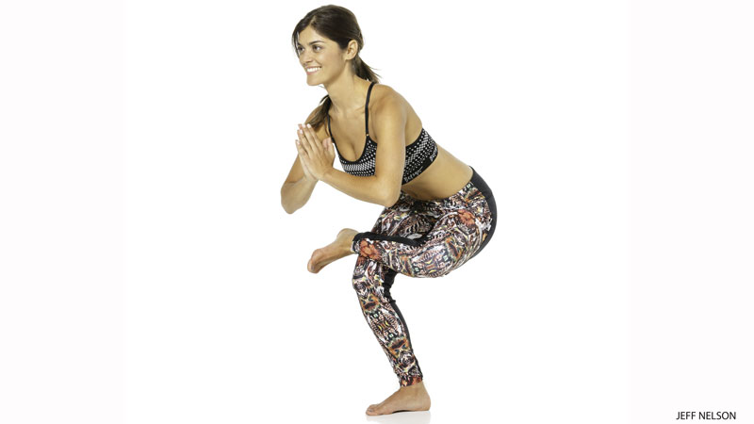
Standing toe balance

Slide 38
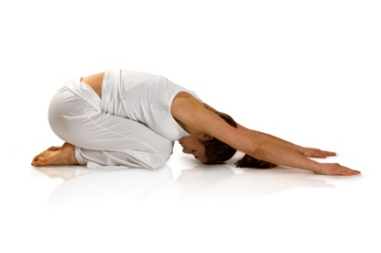
Child’s pose

Slide 39
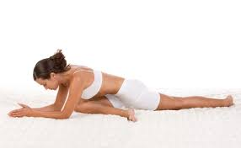
Single pigeon

Slide 40
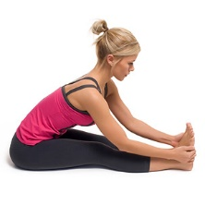
Seated forward fold

Slide 41
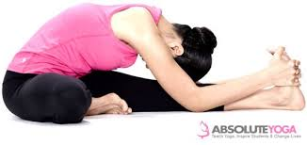
Seated Head to Knee

Slide 42
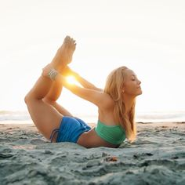
Bow

Slide 43
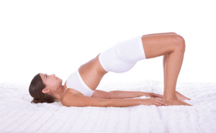
Bridge

Slide 44
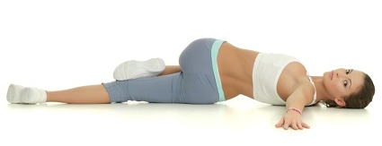
Reclining twist

Slide 45
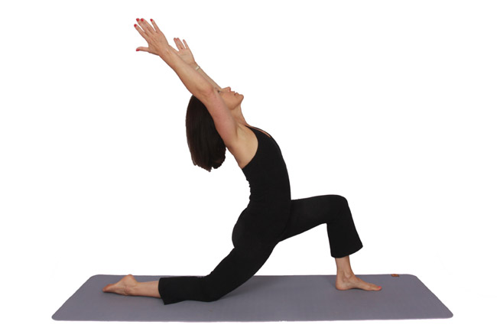
Crescent lunge

Slide 46
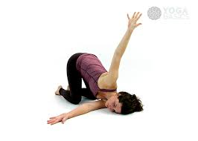
Threading needle

Slide 47

Corpse or savasana

Slide 48

Gate pose

Slide 49

Warrior 1 interlaced fold

Slide 50

Boat twist

Slide 51

Pyramid twist

Slide 52


Forearm plank

Slide 53


Plank or high plank

Slide 54

Goddess twist

Slide 55


Side Plank

Slide 56

Double Pigeon

Slide 57

Warrior one interlaced fold

Slide 58

Revolved Half Moon

Slide 59

Reverse Table

Slide 60

Half Dog at wall

Slide 61

Teeter-totter

Slide 62

Camel

Slide 63

Seated Twist

Slide 64

Wild thing

Slide 65

Revolved head to knee

Slide 66

Fish pose

Slide 67

Crescent twist

Slide 68

Lying twist

Slide 69

Low boat

Slide 70

Sage forward bend

Slide 71

Oak twist

Slide 72

Dragon (crocodile)

Slide 73

Reverse table

Slide 74

Seated twist

Slide 75

Triple downdog

Slide 76


Slide 77

8 angle pose

